Slide 1
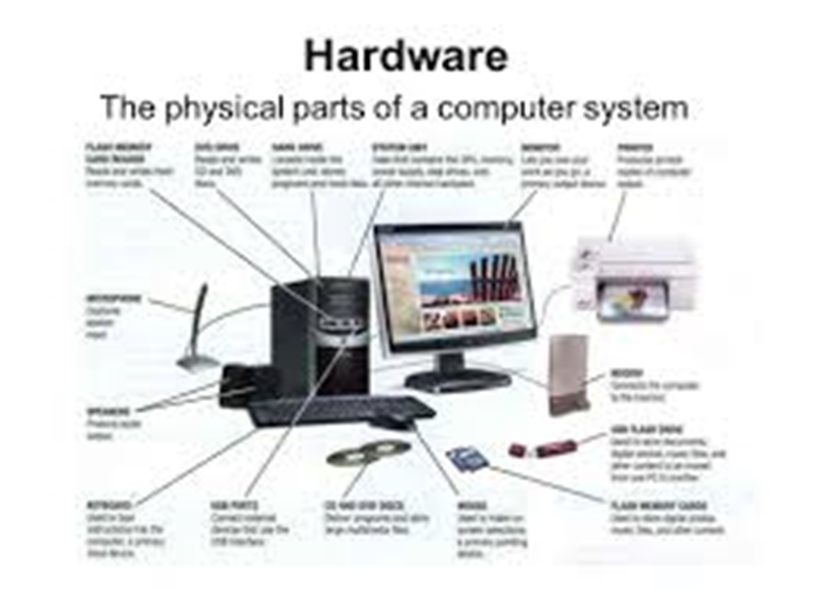
Multimedia Hardware

Slide 2
The Hardware refers to set of all the physical devices attached to computer. The multimedia project requires
High speed Processor.
High volume of random access memory and huge storage volumes.
Various input and output devices like Large screen to display, high resolution printers, scanners, optical mouse, touch screen, speaker, card readers etc.

Slide 3
Input Devices.
The devices which are used to supply input to computer are known as input devices.
A wide variety of input devices are used to create and present multimedia projects.
The input devices includes:
  Keyboard
  Mouse
  Optical Mouse
  Microphone
  Trackball
  Touch Screen
  Light Pen
  Card Readers
  Scanners
  OCR systems.
  Digital Cameras.

Slide 4
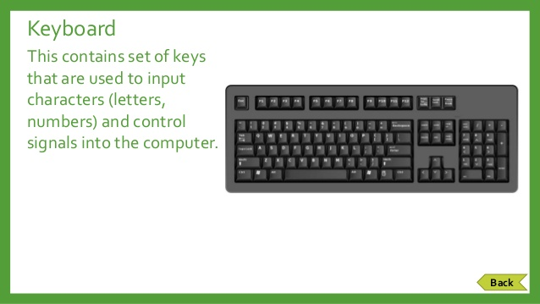
Keyboard
Keyboard is the most common and popular input device. A standard 104 keys keyboard is most commonly used keyboard.
  Numeric keys.
  Character keys.
  Special keys.
  Function keys.

Slide 5
MOUSE
Mouse is used in Graphical User Interface system. A mouse is a pointing device which is used to supply input through its graphical representations called cursor.
The main goal of any mouse is to translate the motion of your hand into signals that the computer can use.

Slide 6
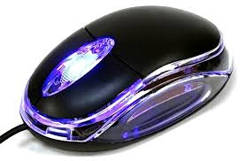
Optical Mouse
The ball mouse suffers from performance degradation as the ball takes dust into the body of mouse, obstructing the proper motion. Thus new generation uses light to track movement.

Slide 7
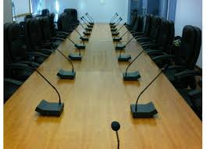
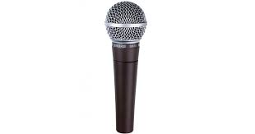
Microphone(converts sound into an electrical signal. )
Microphone is an input device that used to transfer sound inputs to the computer. Microphone are plugged into sound input socket on the sound card of the computer.
As more and more people has started using computers for listening or recording music, chatting and teleconferencing, microphone is one of most.

Slide 8
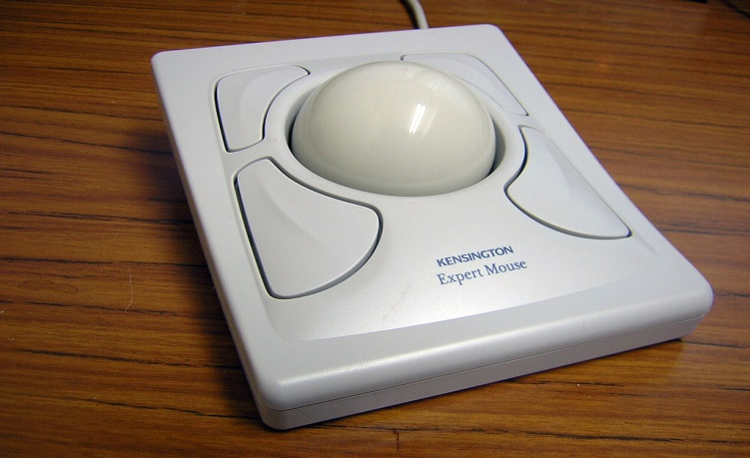
Trackball
It is similar to mouse except one difference that in trackball the ball is fixed in a container that is placed on the desk. Finger can be used to rotate the ball and thus the cursor. It also has buttons like mouse. It is used to position cursor to specific location& I/p supplied by pressing button attached to track ball.

Slide 9
Touch Screen
It is a special input device , which only needs a finger touch to supply input to the system.
Touch screens are the monitors with a special pressure sensitive screen that detects the touch of a finger on a particular point on screen.
Various technologies are used to detect the finger touch on screen.
Some touch screens are pressure sensitive which detect the amount of pressure applied on a particular area of screen.
Touch screens are ideal devices for multimedia kiosks.

Slide 10
Others use infrared beams.
Whenever these beams are obstructed by finger touch , the screen supplies input to the system.
Simply, touching and lifting the finger generates the action of single mouse click.
Touching the screen twice, after a short interval generates the action of mouse double click and touching and moving finger without lifting it, generates the action of mouse drag.
Touch screens are ideal devices for multimedia kiosks.
Advantage:No need of other input device, we can secure all other devices.

Slide 11
Light Pen
It is another pointing device that can be directly used to draw lines on the screen,
It contains a photo cell that is placed on the pen shaped tube.
Whenever this cell is brought closer to the screen it senses the light coming from the screen and it generates the electrical pulses.
In cricket matches, the commentators mark a portion of screen while explaining a particular area.

Slide 12
Card Readers
Multimedia projects often involve authenticating people by using smart cards.
Cards like ATM cards contain magnetic stripes on their back to store important confidential data like password of your ATM.
Smart card is a device that is used to decode the data stored on the magnetic stripes of smart card.

Slide 13
Scanners
It is used to transfer printed or handmade pictures or drawings into computer.
They are cheap and available in different models and resolutions.
The original graphic is placed on a clear glass under which the scanner moves its scanning optics. It sprays light on the paper and the reflected light is read by Charged Coupled Device,which senses the intensity of reflected light and can read every pixel .

Slide 14
OCR
Optical Character Recognition is a software that convert any printed textual information back to the electronic form, which can be processed.
OCR scans the given document and match characters with a library of characters present in the software and then decides that which character is written.
By using OCR ,one can make a text file of your class notes.

Slide 15
Infrared Remotes
An infrared remote is used to interact with multimedia projects without using any wire.
It is similar device to that remote, which is used to change the channel in TV.
It uses infrared rays to transfer the command.

Slide 16
Voice Recognition Systems
It can recognize the voice of the speaker.
These are used to translate voice into commands,
The speaker can interact with the project by just speaking the commands.
Example: Speaking Next will load the next slide in a presentation.

Slide 17
Digital Camera
These are latest type of cameras , which use magnetic or semiconductor technologies to store pictures.
These pictures can be easily transferred to computers at any time.
The price of a digital camera depends on the zoom level, the power of lens and the memory of camera.
Sophistical cameras can store hundreds of pictures in the memory cards.

Slide 18
Audio output device

Slide 19
Speakers and Amplifiers
Speakers are used for producing sound outputs.
They convert the digital signals coming from the computer to analog sound waves. Several sizes and wattage of speakers are available.
To cover a bigger area, amplified speakers and woofers are used.
Amplifiers are the devices which empower the weak sound signal to make it able to be played. on large sized speaker.

Slide 20
Video Output Devices
These are used to produce video output for the user reference. This output can be either a soft output or a hard output.
Soft Output is produced on the monitor
Hard Output is produced on printer.

Slide 21
Monitor
The computer monitor or VDU is an output device that produce soft copy of output to the users.
In its physical appearance ,it resembles with televisions.
Most of computers uses CRT while the portable devices like laptops use LCD, gas plasma of other projection technologies.

Slide 22
Flat Panel Display
The most common flat panel display is LCD.
It produces image by aligning molecular crystals.
When a voltage is applied, the crystals line up in a way that blocks light from passing through them; the absence of light is seen as characters on the screen.
In addition to small sizes, it has a major advantage that it is safer to human eyes as it doesn't flicker.

Slide 23
Printers
Printers are mainly used hard copy output devices that produced a hard copy of output on the paper.
Printers can be classified as impact and non-impact printer
Impact printers produce the output by touching the paper
Non-impact printers produce the output without touching the paper.

Slide 24
INKJET PRINTER
It is non-impact printer that contain cartridges of liquid ink.
These cartridges are arranged in a print head, that contain tiny holes to spray the liquid ink.
When the print command is fired , the printer sends information signals to the head.
By using these signals , the head sprays ink droplets on paper. The ink is specially designed to quickly absorbed by paper.

Slide 25
Laser Printer
Popular non-impact printer.
Laser printer have high initial costs but they have very low operating cost.
The laser can generate a high quality output less than 100 paisa.
The main advantage Laser printer is Speed Lasers have maximum speed of printing.
If you want high speed printing along with very high speed printing with very high quality output , then use laser printer.

Slide 26
A head fires a laser on the drum to draw an inverted image to the output.
The drum is charged with a negative charge on this portion.
The dry positively charged ink immediately sticks on the portion of the drum,where the output was drawn.
The drum rotates and transfer the image on the paper.
After this paper is passed through a heater which fixes the powdered ink on the paper.

Slide 27
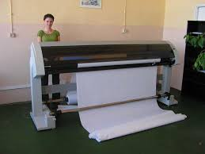
Plotters
Plotter is a large sized printer , which is used to print maps and reports that are very large in size.
The main advantage of plotters is reproducing line drawings with a very high degree of accuracy.
Plotters can draw with an accuracy of 1000th of an inch

Slide 28
Optical Storage
It is a storage media that use light to read and write data , are called as optical storage.
The classification of optical disks would be easy if we arrange them in a series which are read only , recordable and re-recordable.
Popular due to portability and very high data density.

Slide 29
CD
A CD is a round disk of clear polycarbonate plastic, coated with very thin reflective metallic layer.
CD can store data upto 700 MB.
Compact disc (CD) is a digital optical disc data storage format released in 1982 and co-developed by Philips and Sony.
The CD can store data, audio and video equally well and are widely used for these purposes.
The CD that can be written only once and can be read for many times are called as WORM(Write Once Read Many).
CD-R(Recordable) and CD-RW(Rewritable).

Slide 30
DVD
Digital Versatile Disk or digital video disk.
DVD ROM stored 4.7 GB data on single sided which had same size as that of CD.
Newer version can store 9.4 Gb of data.
DVD has layered structure and extremely high data density, which make it capable of storing 17GB in one single disk

Slide 31
Advantage of optical storage
Offers very high storage capacity.
Offers very high data density.
Has very Compact size.
Has very low cost.

Slide 32
Image and Audio Image Formats
Jpeg Format (Extension : .JPG, .JPEG) : Joint Photographic Experts Group. This format is optimised for the display of photographs. Following are two main features of JPEG images :
  It uses a lossy compression scheme.
  It supports 24-bit color.
  The degree of compression can be adjusted, allowing a selectable tradeoff between storage size and image quality.
  Don’t use JPEG to save original images that you want to modify later on. As you go through various saves the image become more and more degraded.

Slide 33
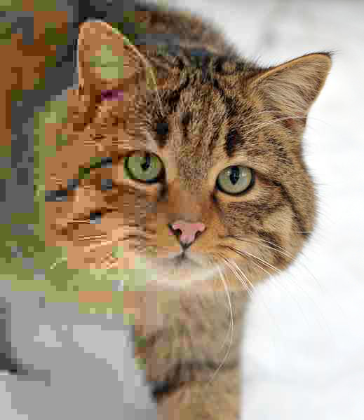
A photo of a wildcat with the compression rate decreasing, and hence quality increasing, from left to right.

Slide 34
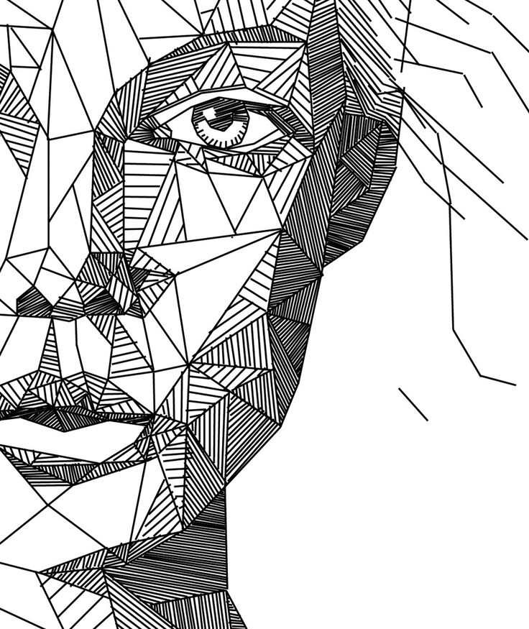
TIFF Format( Extension: .Tif) Tagged Image File Format is a file format for storing images including photographs and line arts.
This is commonly used in Digital Photography.
TIFF is widely supported by scanning, faxing, word processing, optical character recognition, image manipulation, Desktop Publishing, and page-layout application.
unlike standard JPEG files, a TIFF file using lossless compression (or none) may be edited and re-saved without losing image quality.
It follows Lossless compression and supports various color spaces like that of RGB, CMYK,.

Slide 35
PNG ( Extension: .png) Portable Network Graphics is a bitmapped image format that employs lossless data compression. Images compressed with PNG however do not reduce the file sizes as much as JPEG compression. PNG is the 3rd most common image format used beaten by only JPEG and GIF.
GIF (Extension: .GIF) Graphics Interchange Format is a bitmap image format a common file format taht can be displayed on all web browsers and it displays images in 256 colors and has built in lossless- compression.

Slide 36
BMP Format (Extension: .BMP) also known as device independent Bitmap (DIB) is an image format used to store bitmap images specially for Microsoft OS.
A graphic image stored as a specific arrangement of screen dots or pixels.
It is uncompressed format .

Slide 37
EPS (Extension .EPS) Encapsulated Post Scripts files developed by adobe for post script printers.
The content of these file can be edited by very few programs such as Adobe Illustrator

Slide 38


